Slide 1

Navigating the Wild Seas of ES6 Modules
August 2015

Slide 2
There be dragons!

Slide 3



The Node Dragon
Sonnet 130
The Dragon of Syntax
The Browser Dragon

Slide 4
The Dragon of Syntax

Slide 5
Creating a module
export function doIt() {}
export var meaningOfLife = 42;
function doThat() {}

Slide 6
Using a module
a-module.js
export function doIt() {}
export var meaningOfLife = 42
function doThat() {}
import {doIt, meaningOfLife} from 'a-module';
Simple, right?

Slide 7
You Wish!

Slide 8
TIMTOWTDI

Slide 9
There Is More Than One Way To Do It
function doIt() {} var aVar = 42; function doThat() {...}
export {doIt, aVar as meaningOfLife};

Slide 10
There Is More Than One Way To Do It
import * as lib from 'a-module'; lib.doIt(); lib.meaningOfLife;

Slide 11
AAAAARRRGGGGGHHH!!!

Slide 12
The dreaded default
a-module.js
export default 42;
import meaningOfLife from 'a-module';

Slide 13
Confusion will be my epitaph
export default function doIt() {} export default var meaningOfLife = 42;
✓
WTF?
✕

Slide 14
default is just another import
import orOther, {something} from 'a-module'; import {something}, orOther from 'a-module'; import {something, default as orOther} from 'a-module';

Slide 15

TJTMWTTD!

Slide 16
There’s Just Too Many Ways To Do Things!

Slide 17
Why Did This Happen?

Slide 18
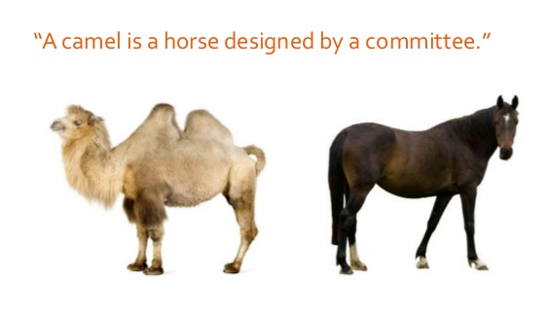

Slide 19
So?

Slide 20

Do we abandon ship?

Slide 21
No!

Slide 22
Prefer default over specific exports
export default function factory() {}
or...
export default { doIt() {} meaningOfLife: 42 }
Notes:
This works well with the idea of modules as small pieces of code

Slide 23
Prefer const var bindings
export const meaningOfLife = 42;

Slide 24
The Node Dragon
Sonnet 130
The Dragon of Syntax
The Browser Dragon

Slide 25
The Node Dragon

Slide 26
How do we use ES6 modules in Node?

Slide 27
Why would we do that?

Slide 28
Node has a really good module system

Slide 29
Node module
a-module.js
exports.doIt = function() {} exports.meaningOfLife = 42;
So Why?
const {doIt, meaningOfLife} = require('a-module');

Slide 30
Two words:
isomorphic code

Slide 31
So How?

Slide 32
Native ES6 modules: ongoing work

Slide 33
Till then...

Slide 34
Babel!
require("babel/register");

Slide 35
Babel!
export function doIt() {}
exports.doIt = function() {}
Interoperability
import {doIt} from 'a-module'
var {doIt} = require('a-module')

Slide 36
default
export default 42;
exports['default'] = 42
Interoperability?
import mol from 'a-module'
var {default: mol} = require('a-module')

Slide 37
And this?
var aModule = process.arch === 'win32' ? require('a-module-win32') : require('a-module') //...
Nope

Slide 38
Huh? No dynamic loading of modules?

Slide 39
There is!
var moduleName = process.arch === 'win32' ? 'a-module-win32' : 'a-module’ System.import(‘a-module-win32’).then( aModule => { /* ... */})

Slide 40
But it’s async!
the node people and ES6 people are currently discussing how to resolve this

Slide 41
So?

Slide 42

Do we abandon ship?

Slide 43
No!

Slide 44
Do this
Use import/export when you can
Fall back to require if you must

Slide 45
The Node Dragon
Sonnet 130
The Dragon of Syntax
The Browser Dragon

Slide 46
The Browser Dragon

Slide 47

The fiercest dragon of them all

Slide 48

A whole talk unto itself

Slide 49
But maybe a glimpse?

Slide 50
This is illegal
<script>
import {doIt} from 'a-module'; // …
</script>

Slide 51
You have to do this
<script>
System.import('a-module').then( ({doIt}) => // ... );
</script>

Slide 52
Or...
<script type=module>
import {doIt} from 'a-module'; // …
</script>

Slide 53
Or maybe...
<module>
import {doIt} from 'a-module'; // …
</module>

Slide 54

Who knows? The spec hasn’t been updated in 10 months!

Slide 55

Extra! Extra! Read all about it!
Modules have their own scope

Slide 56
So forget about this
<module>
import {doIt} from 'a-module'; // …
</module>
<div onclick=doit>...</div>

Slide 57
Interoperability with AMD
e.g. RequireJS?
Maybe. There’s another spec, the Loader spec, which is dealing with this
Work in progress. Not yet close to ready.
And has interoperability problems with Node

Slide 58
And how would this work efficiently?
<module src= ></module>

Slide 59


Slide 60
So?

Slide 61

Do we abandon ship?

Slide 62
No!

Slide 63

The One-Two Punch

Slide 64

Punch #1

Slide 65
We’ve already seen it (Babel)
export function
doIt() {}
exports.doIt =
function() {}
import {doIt}
from 'a-module'
var {doIt} = require('a-module')

Slide 66

Punch #2

Slide 67
Bundling CommonJS modules
bundle.js

Slide 68
Use...
Grunt or Gulp or Brocolli or npm scripts
Babel or Traceur or esnext
webpack or browserify
Oh How Fun!

Slide 69
But if you do all this, you get a very sweet carrot

Slide 70
Isomorphic code between Node and the Browser

Slide 71
The Node Dragon
Sonnet 130
The Dragon of Syntax
The Browser Dragon

Slide 72
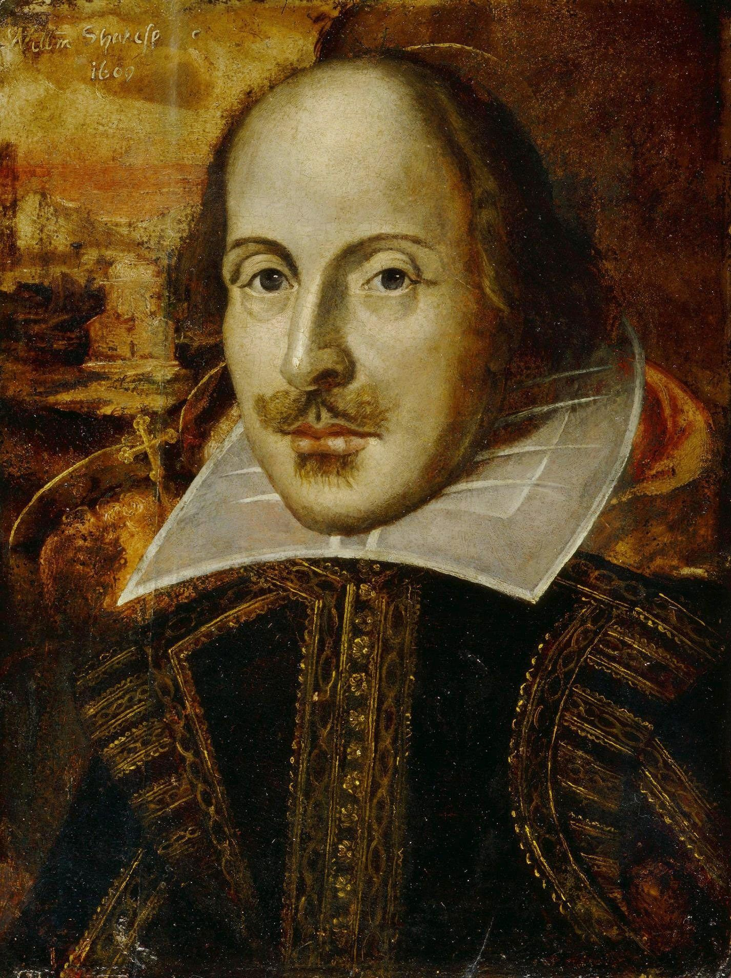

Slide 73
Sonnet 130
My mistress’ eyes are nothing like the sun;
Coral is far more red than her lips’ red;
If snow be white, why then her breasts are dun;
If hairs be wires, black wires grow on her head.
I have seen roses damasked, red and white,
But no such roses see I in her cheeks;
And in some perfumes is there more delight
Than in the breath that from my mistress reeks.
I love to hear her speak, yet well I know
That music hath a far more pleasing sound;
I grant I never saw a goddess go;
My mistress when she walks treads on the ground.
And yet, by heaven, I think my love as rare
As any she belied with false compare.

Slide 74
So Go...
...and love ES6 modules like you love your beloved:
it’s never perfect,
but it’s still wonderful,
and it gets better over time

Slide 75
Thank You
gil@tayar.org, @giltayar

